Slide 1
Present Perfect
with
already - yet - just

Slide 2
Complete the table, then classify the verbs
 | Past Simple | Past Participle
Play |  | played
Finish
Borrow | borrowed
Arrive
Drink |  | drunk
See
Have
Help
Be | was / were
Give
Know
Regular
played
played
1-
2-
3-
4-
5-
finished
finished
finished
borrowed
borrowed
arrived
arrived
arrived
helped
drank
saw
seen
Irregular
had
had
drink- drank- drunk
1-
2-
3-
4-
5-
6-
helped
helped
see-saw-seen
have-had-had
been
be-was/were-been
gave
given
give-gave-given
knew
known
Know-knew-known

Slide 3
just already yet
х
↓

We use just when an action happened recently
I have just eaten breakfast
We use already when an action happened
sooner than expected
I have already finished page 20
We use yet when we think an action will happen soon
I haven`t eaten lunch yet

Slide 4
I`ve already cleaned my room
DONE
She has already sent the mail

I haven`t cleaned my room yet.
PLAN
TO DO
She hasn`t sent the mail yet.
х
Have you finished your work yet?.
I`ve just cleaned my room.
RECENTLY DONE
↓
She has just sent the mail.

Slide 5
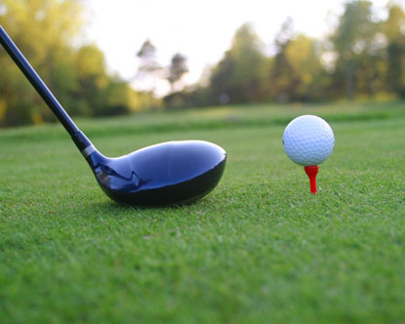
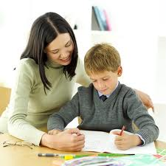
MAKE SENTENCES FOR THE PICTURES

Play golf
He has already played golf. Now he`s going to play tennis.
х
Finish the homework
He hasn`t finished
the homework yet.

Slide 6
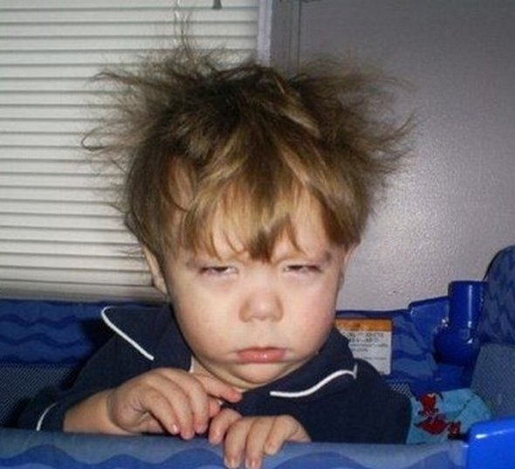
Wake up
↓
He has just woken up.
Watch 7 cajas

I`ve already watched
«7 cajas» three times

Slide 7
Make a list of the things you have done and the things you plan to do soon
go the break, have lunch, finish English class, have P.E, play basketball, send 50 messages today, take a nap, watch TV.

х
DONE
PLAN TO DO
go the break
have lunch

Slide 8
Ask questions to your partner
Examples:
A- Have you gone to the break yet?
B- Yes, I have already gone to the break
No, I haven`t gone to the break yet.
A- Have you had lunch yet?
B- Yes, I have already had lunch.
No, I haven`t had lunch yet.

Slide 9
The end! ☺
Hugs with social distance!

