Slide 1
Adjectives
IMPORTANTE
TRABAJA ESTE PPT CON TU GUÍA
Vocabulario II
Making a comparison

Slide 2
Pay attention
Objective: Comparar dos cosas o personas
Para comparar necesitamos adjetivos. ¿Qué es un adjetivo?
Un adjetivo sirve para describir - menciona las cualidades de un sustantivo

Slide 3
HEALTHY

Slide 4
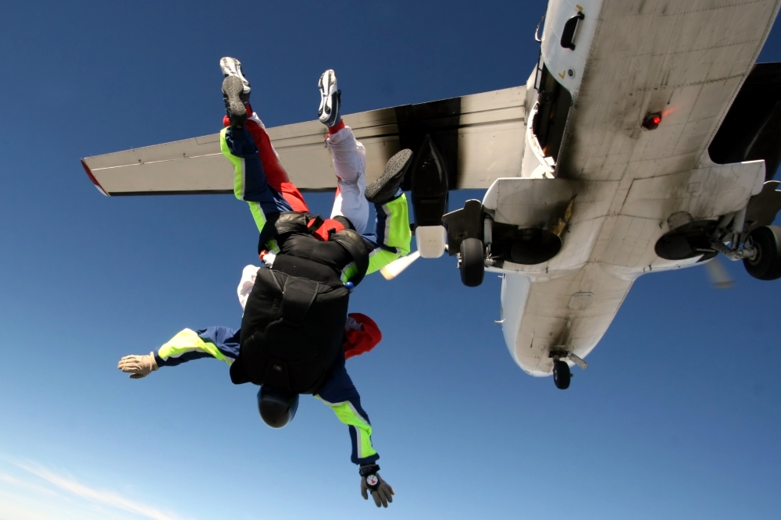
EXCITING

Slide 5
INTERESTING

Slide 6
LOUD

Slide 7
CHEAP

Slide 8
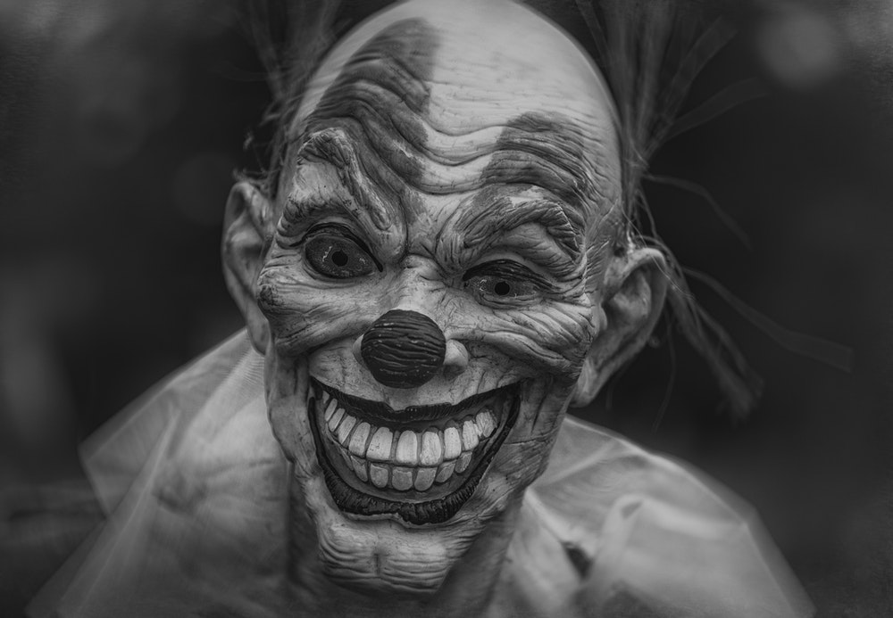
SCARY

Slide 9
BORING

Slide 10
FRIENDLY

Slide 11
ATTRACTIVE

Slide 12
ENJOYABLE

Slide 13
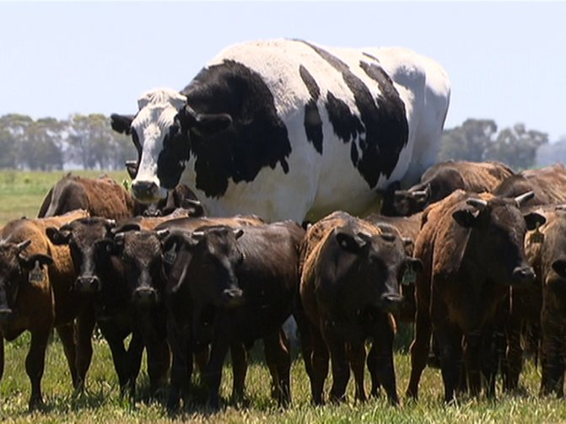
large

Slide 14
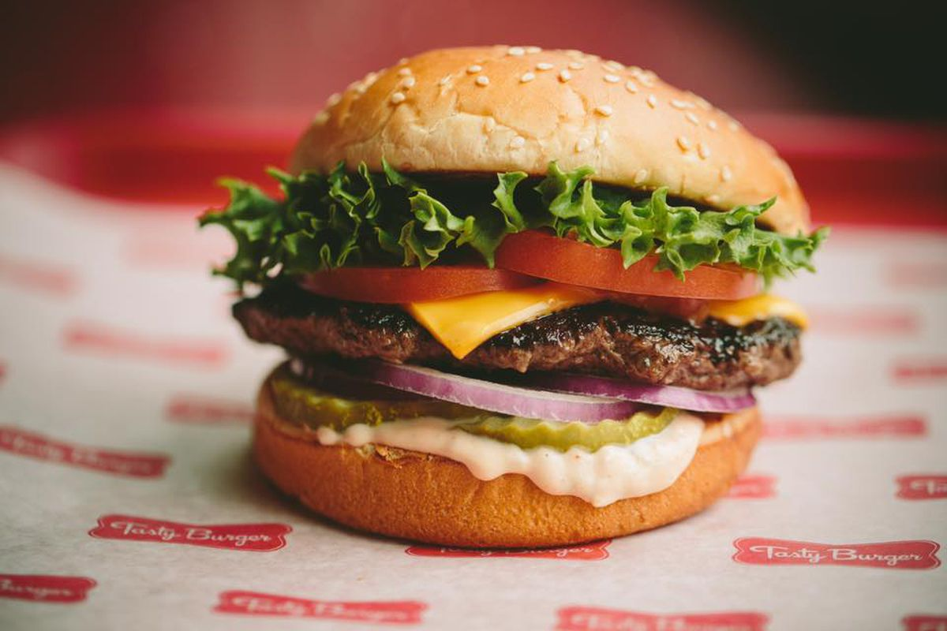
tasty

Slide 15
comfortable

Slide 17
Trabaja con tu guía
Put a tick to tell what you think.
enjoyable |  | swimming
 |  | running
attractive |  | Shawn Mendes
 |  | Drake
cheap |  | designer clothes
 |  | clothes from a market
boring |  | reading the newspaper
 |  | watching the news on TV
large |  | Sahara desert
 |  | Atacama desert
tasty |  | Indian food
 |  | pasta
friendly |  | cats
 |  | dogs
comfortable |  | camping
 |  | staying in a hotel

Slide 18
Comparatives
1. Use than to make a comparison
Dogs are friendlier than cats

Slide 19
2. One syllable adjectives, add “er” to the adjective
tall → taller
cheap → cheaper

Slide 20
3. two-syllable adjectives and all longer ones add “more”
Boring → more boring
Beautiful → more beautiful

Slide 21
4. Adjectives ending in
vowel + consonant, double the consonant: +er (except –w or –x)
big → bigger low → lower

Slide 22
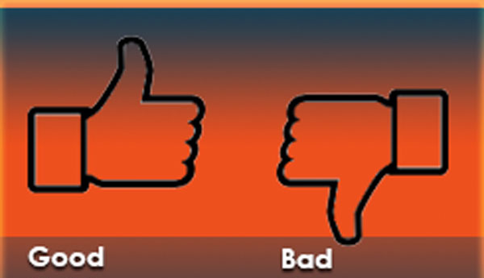
5. Irregular adjectives
Good → better bad → worse

Slide 23
6. Adjectives ending in consonant + -y, change to i and add –er
happy → happier

Slide 24
example
Swimming is more enjoyable than running
enjoyable |  | swimming
 |  | running
https://www.youtube.com/watch?v=eA46BhGhp9Q

