Slide 2
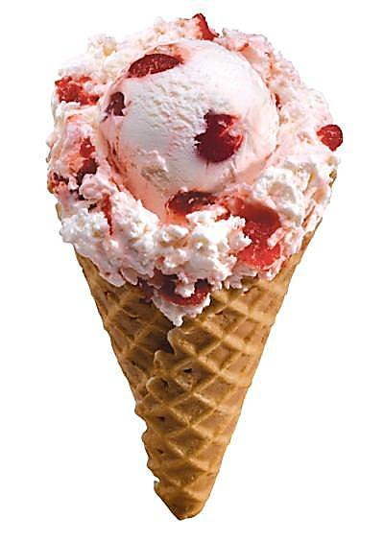
I love eating ice cream

Slide 3
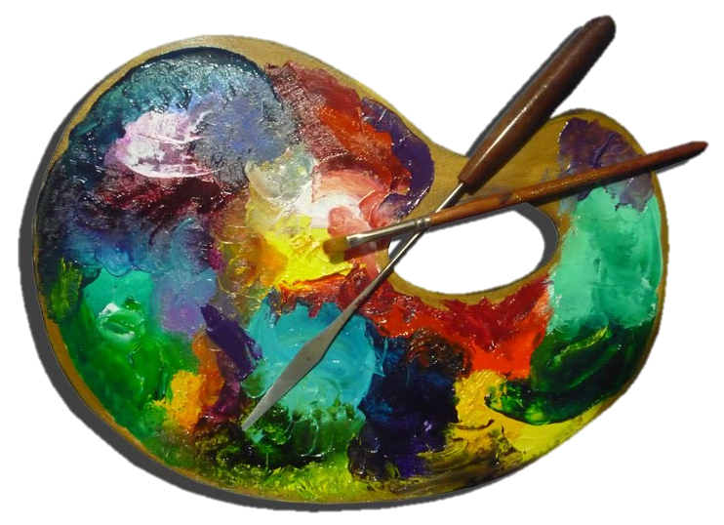
I like painting beautiful pictures

Slide 4
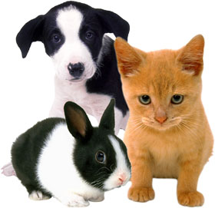
I like helping animals

Slide 5
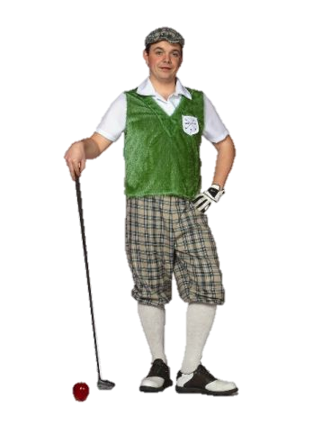
I enjoy playing golf

Slide 6
I don’t like studying maths

Slide 7
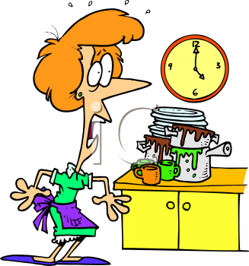
I hate washing dishes

Slide 8
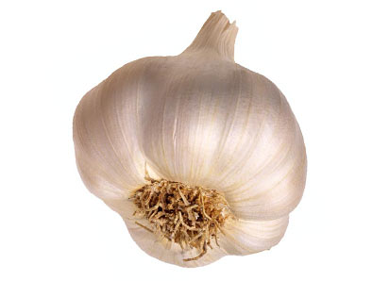
I can’t stand eating garlic

Slide 9
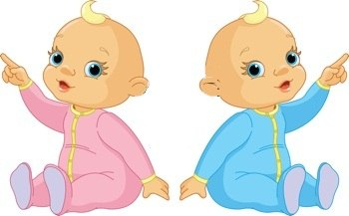
MAKE A SENTENCE
Babies like drinking milk.
?

Slide 10
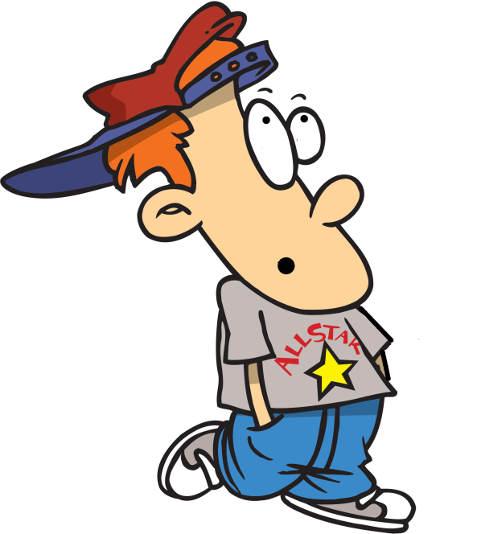
MAKE A SENTENCE
He doesn’t like eating cheese.
?

Slide 11
MAKE A SENTENCE
She hates cooking.
?

Slide 12
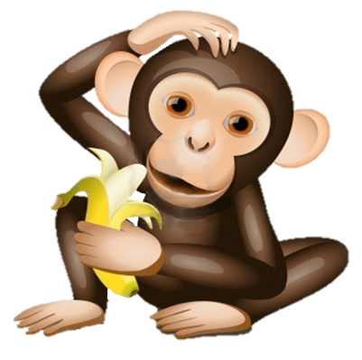
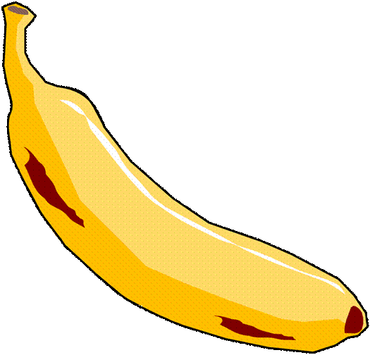
MAKE A SENTENCE
Monkeys love eating bananas.
?

Slide 13
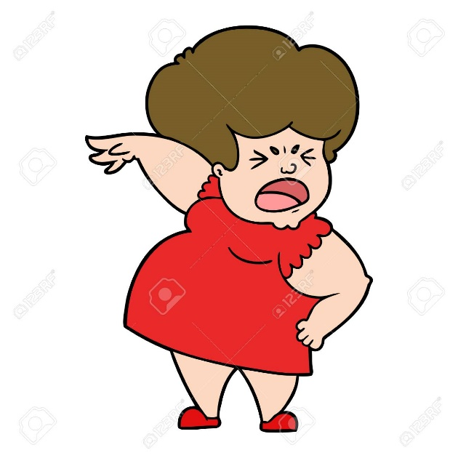
MAKE A SENTENCE
She can’t stand eating garlic.
?

Slide 14
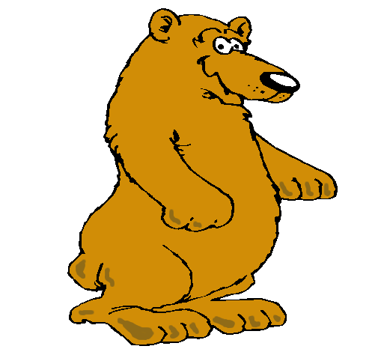
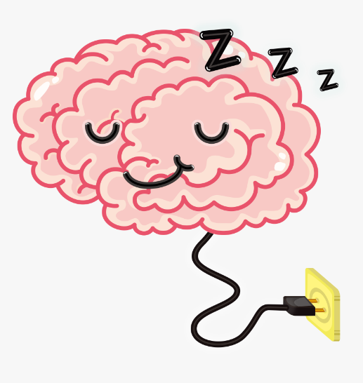
MAKE A SENTENCE
Bears like sleeping a lot
?

Slide 15
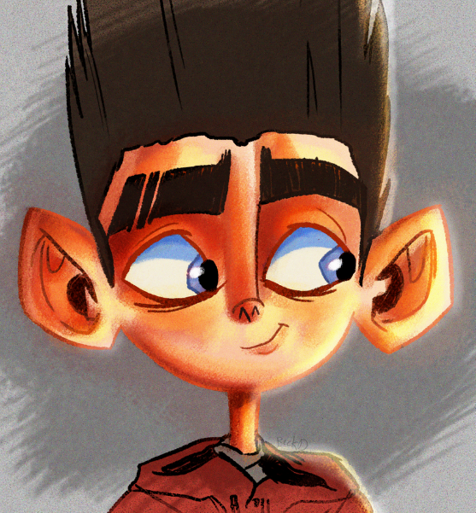
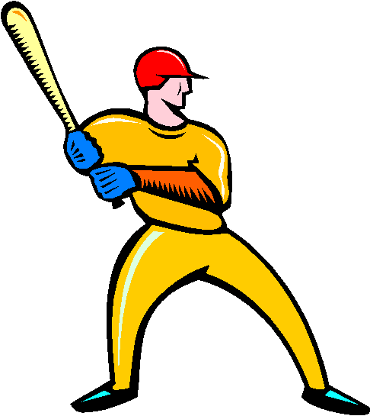
MAKE A SENTENCE
He enjoys playing baseball.
?

Slide 16
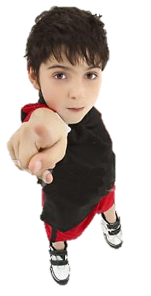
What about you?

