Slide 1
Either… Or Neither… Nor

Slide 2
CHAT ......
People can EITHER chat on the computer OR the mobile phone.
My daughter can NEITHER chat on the computer NOR the mobile phone.

Slide 3
Either…… Or
Either … or is used in a sentence in the affirmative sense when referring to a choice between two possibilities.
E.g. We can either eat now or after the movie. You decide.

Slide 4
Either…… Or
Either is always followed by or.
E.g. We could choose either sushi or noodles from the menu.

Slide 5
Either…… Or
If both elements are singular, then the verb is singular too.
E.g. Either the father or the mother has to attend the meeting. (father and mother are singular; so the verb has, is singular too)

Slide 6
Either…… Or
If one of the elements is plural, then use a plural verb.
E.g. Either Sue or the girls are going to prepare dinner tonight. (the girls is plural; so the verb are, is plural too)

Slide 7
Neither … Nor
Neither . . . nor is used in the negative sense when you want to say that two or more things are not true.
E.g. Neither my mother nor my father went to university.

Slide 8
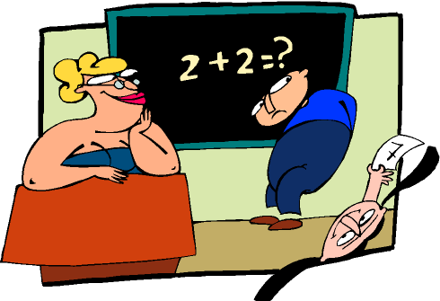
Neither … Nor
Neither is always followed by nor.
E.g. Neither Tom, nor Peter could solve the problem.

Slide 9
Neither … Nor
If both elements are singular, then the verb is singular too.
E.g. Neither Leila nor Nancy is going to write the report. (Leila and Nancy are singular; so the verb is, is singular too)

Slide 10
Neither … Nor
If one of the elements is plural, then use a plural verb.
E.g. Neither the teacher nor the students were in the classroom this morning. (the students is plural; so the verb were, is plural too)

Slide 11
Either… Or Neither… Nor
Fill in either: either . . . or, neither . . .nor.
This is my offer. You take it leave it.
You can ___ use this computer that one. They need to be repaired first.
I have tomatoes onions growing in my garden. I don’t eat vegetables.
You can have Thomas Peter over, but not both.
You can come with me now walk home.

Slide 12
Either… Or Neither… NoR ANSWERS
Fill in either: either . . . or, neither . . .
This is my offer. You either take it or leave it.
You can neither use this computer nor that one. They need to be repaired first.
I have neither tomatoes nor onions growing in my garden.
You can have either Thomas or Peter over, but not both.
You can either come with me now or walk home.

